Slide 1
UMD DATA605 - Big Data Systems Course Intro Big Data
Data Models
Dr. GP Saggese
gsaggese@umd.edu
with thanks to Prof.
Alan Sussman
Amol Deshpande

Slide 2
UMD DATA605 - Big Data Systems Course Intro Big Data
Data Models

Slide 3
Goals / objectives
Learn to model and reason about data
Learn how to process and manipulate data in different ways
Introduce a variety of data models
Decide which data model is appropriate for different applications
Learn to use a variety of data management systems
Decide which system is appropriate for a data management scenario
Learn how to build data processing pipelines
Learn how to build a big-data system end-to-end
Class project!
Team work

Slide 4
Class
DATA605 - Schedule
DATA605 - GitHub repo
How to get in touch with me / TA
Piazza
Telegram channel for discussions

Slide 5
Why I Am Interested in Big Data
https://www.linkedin.com/in/gpsaggese/
Sorrentum
Open-source project I’ve started
GitHub

Slide 6
Todos
Make sure you are signed up for Piazza!
Check out the DATA605 GitHub repo
Begin setup of your computing environment
Install Docker on your laptop
Instructions are in the class repo

Slide 7
Tools We Will Learn To Use
Languages: mainly Python
Dev tools
Bash / Linux OS
Git (branching, understand data model)
GitHub (PRs, fork a project)
Code editors (PyCharm, Visual Studio, vim / emacs)
Data science libs (pydata stack: numpy, Pandas, sklearn, matplotlib)
Jupyter notebooks
Docker
Unit testing framework
Big data tools
ETL pipelines
Workflow manager (Airflow)
Relational databases (PostgreSQL)
NoSQL (HBase, MongoDB, Couchbase, Redis)
Graph DBs (Neo4j, OrientDB, AllegroGraph, GraphX, Giraph)
Computing (Hadoop, Spark, Dask, Storm, Spark Streaming)
Cloud Services (AWS)
Tutorials for each tool we use for the class project

Slide 8
Soft Skills to Succeed in the Workplace
Skills that people coming out from college often don’t have
Goal: we will try to model the class to prepare you for the workplace
Work in a team
Design software architecture (e.g., OOP, Agile, Design Patterns)
Comment your own code
Write external documentation (e.g., tutorial, manuals, how-tos)
Write code so that other people can understand (including future-you)
Read other people’s code
Follow code conventions (e.g., PEP8, Google Code)
Be clear in communications (e.g., in emails, Slack)
File a bug report
Reproduce (aka repro) a bug
Have a sense of CS constants
Have a sense of how an OS works (e.g., virtual memory, processes)

Slide 9
Class Project
DATA605 - Class project
Build an end-to-end big data system importing data, computing, orchestrating the tasks
Teams of 4-5 students
GP and the TA will create well-balanced teams
Review 2 examples of complete projects
5 deliverables with deadlines graded individually (20% of final grade)
Every class 1 hour of group work with GP + TA
Peer evaluation of the project
Grad and undergrad students will be assigned final grades separately
Will re-evaluate based on how projects go
Student survey
Collect some information about you to organize groups for the class project
Check out Sorrentum project and repo

Slide 10
UMD DATA605 - Big Data Systems Course Intro Big Data
Data Models

Slide 11
Data Science
Promises of data science (DS)
Give a competitive advantages
Make better strategic and tactical business decisions
Optimize business processes
Detect strategic blind spots
Data science is not new, it was called:
Decision support
Business intelligence
Predictive analytics
Operation research
...
What has changed is that learning and applying DS is easy
No need for consulting groups
Tools are open-source
E.g., Python + pydata stack (numpy, scipy, Pandas, sklearn)
Large data sets
Cheap computing (e.g., AWS, Google Cloud)

Slide 12
Motivation: Data Overload
McKinsey, 2013: “data science is the number one catalyst for economic growth”
Growing amount of data
Cloud computing
Build machine models to make better business decisions
Explosion of data in every domain
Sensing devices / networks monitor processes 24/7
E.g., temperature of your room, your vital signs, pollution in the air
Increasingly sophisticated smart-phones (6.5b smart phones, 80% of the world population)
Internet and social networks make it easy to publish data
Internet of Things (IoT), everything is connected to the internet
E.g., power supply, toasters
Scientific experiments and simulations produce enormous volumes of data
Datafication: turn all aspects of life into data
E.g., what you like/enjoy turned into a stream of your "likes”
Challenges
How to handle increasing amount data?
How to extract interesting actionable insights and scientific knowledge?

Slide 13
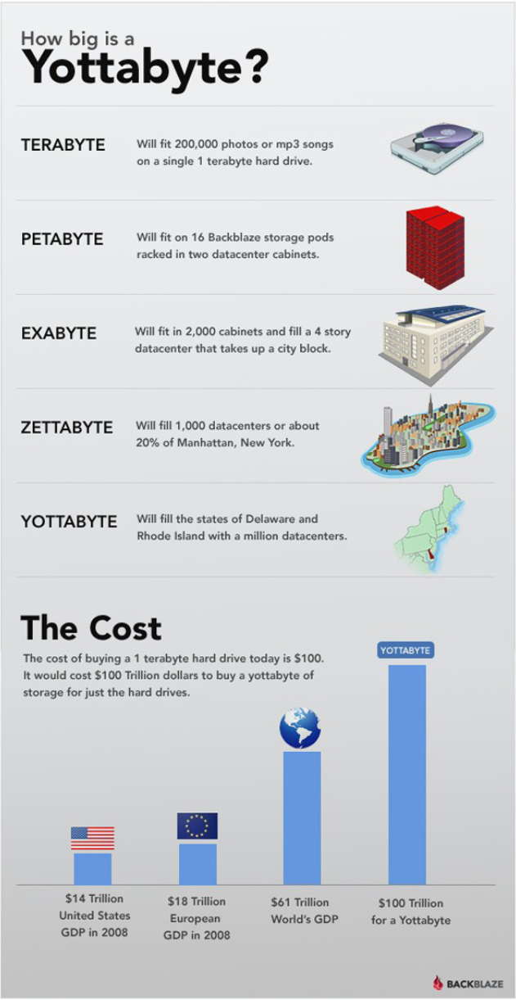
Scale of Data Size
Megabyte = 2¹⁰ \approx 10⁶ bytes
Typical English book
Gigabyte = 10⁹ bytes
1/2 hour of video
Wikipedia (compressed, without media): 22GB
Terabyte = 1m MB
Human genome: ~1TB
200,000 photos
LHC generates 100TB of data per day
$50 to buy 1TB HDD, $23 / mo on AWS S3
Petabyte = 1000 TB
13 years of HD video
65 copies of Library of Congress
$250k / year on AWS S3
Exabyte = 1m TB
Global yearly Internet traffic in 2004
Zetabyte = 1b TB = 10²¹ bytes
Global yearly Internet traffic in 2016
Yottabytes = 10²⁴ bytes
1TB today costs ~$100, Yottabyte costs $100t
Brontobytes = 10²⁷ bytes

Slide 14
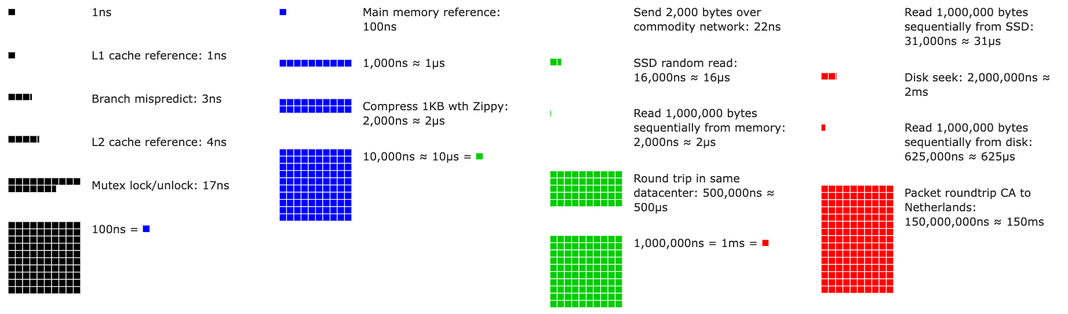
Constants that everybody should know
From Latency Numbers Every Programmer Should Know (by year)
A CPU running at 3GHz executes an instruction every 0.3ns
L1 cache reference / register: 1ns
L2 cache reference: 4ns
Main memory reference: 100ns
Send 1KB over network: 10ns
Read 1MB from memory: 2us
SSD random read: 16us
Disk seek: 2ms
Packet round-trip from CA to Netherland: 150ms
Notes:
There are 1e9 nanoseconds in a second
In a year there are 32m seconds
It’s a ~ a blink of an eye 300ms (3 blinks per seconds)
If 1 second is 10 year, a nanosecond is one blink of an eye

Slide 15
Big Data Applications
Personalized marketing
Target each consumer instead of the consumers at large
E.g., Amazon personalizes suggestions using signals from:
Your shopping history
What you have searched for (or clicked, watched)
Other consumers and trends
Reviews (through NLP and sentiment analysis)
Brands want to understand how customers relate to products
Use sentiment analysis from
social media
on-line reviews
blogs
surveys
Positive, negative, neutral feeling
E.g.,
In 2022, $600b spent on digital marketing
50 Stats Showing The Power Of Personalization

Slide 16
Big Data Applications
Mobile advertisement
Mobile phones are ubiquitous
80% of world population has one
Integration of on-line and off-line databases, e.g.,
GPS location
Search history, credit history, credit card transactions
E.g.,
You’ve bought a new house
You google questions about house renovations
You watch shows about renovations
Your phone tracks where you are
Google sends you coupons for the closest Home Depot

Slide 17
Big Data Applications
Biomedical data
Personalized medicine
Patients can receive treatment tailored to them to maximize efficacy
Genetics, daily activities, environment, habits
Genome sequencing

Slide 18
Big Data Applications
Smart cities
Interconnected mesh of sensors
E.g., traffic sensors, camera networks, satellites
Goals:
Monitor air pollution
Minimize traffic congestion
Optimal urban services
Maximize energy savings

Slide 19
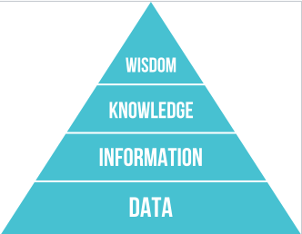
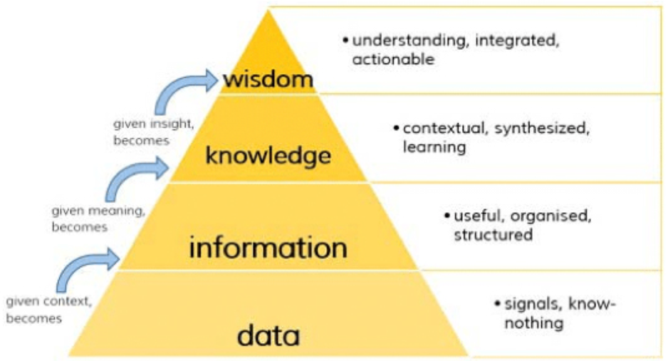
Goal of Data Science
Goal of data science: from data to wisdom
Data (raw bytes)
Information (organized, structured)
Knowledge (learning)
Wisdom (actionable, understanding)
Combine streams of big data to generate new data
New data can be “big data” itself
Insights enable decisions and actions

Slide 20
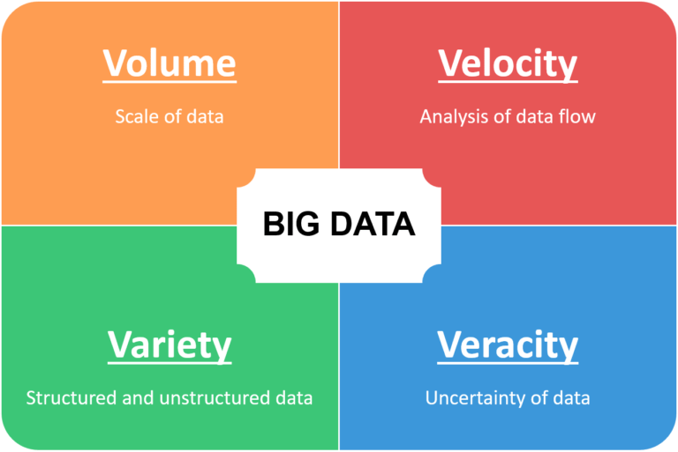
Four V’s of Big Data
Big data often exhibits certain characteristics and qualities
Volume
Vast amount of data is generated
Variety
Different forms
E.g., text, images, voice, geospatial data
Velocity
Speed at which data is generated
Veracity
Biases, noise, abnormality in data
Uncertainty, trustworthiness
(Valence)
Connectedness of big data in the form of graphs
(Value)
Challenges of big data can distract from focusing on how big data benefits an organization

Slide 21
Four V’s of Big Data
Volume
Exponentially increasing amount of data
Every day 2.5 exabytes (1m of TB) of data is generated
90% of all the data in the world was generated in the last 2 years
Total amount of stored data doubles every 1.2 years
Twitter: 500M tweets / day (2022)
Google processes 8.5b queries / day (2022)
Facebook generates 4PB of data / day (2022)
Walmart: 2.5PB of unstructured data / hour (2022)
Variety
Different form
Structured data (e.g., spreadsheets, relational data)
Semi-structured data (e.g., natural language text, sales receipts, your class notes)
Unstructured data (e.g., photos, videos)
Different formats (e.g., flat files, CSV, XML, JSON)

Slide 22
Four V’s of Big Data
Velocity
Relates to the speed at which data is generated
E.g., sensors generating data streams
Sometimes data can be processed off-line
Real-time analytics requires data to be consumed as fast as it is generated
Veracity
Relates to data quality
How to remove noise and bad data?
How to fill in missing values?
What is an outlier?
How do you decide what data to trust?

Slide 23
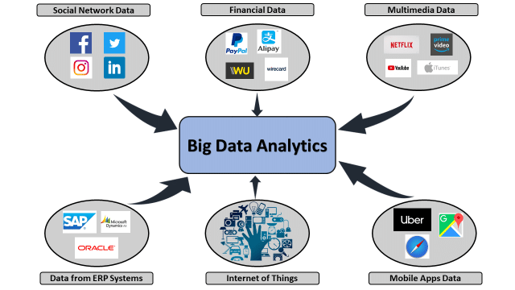
Sources of Big Data
We can distinguish Big Data in terms of its source
Machines
People
Organizations

Slide 24
Sources of Big Data
Machines generate data
Real-time sensors (e.g., sensors on Boeing 787)
Cars
Website tracking
Personal health trackers
Scientific experiments
Pros
Highly structured
Cons
Can’t be easily moved, but need to be computed in-situ or in centralized fashion
Streaming, not batch

Slide 25
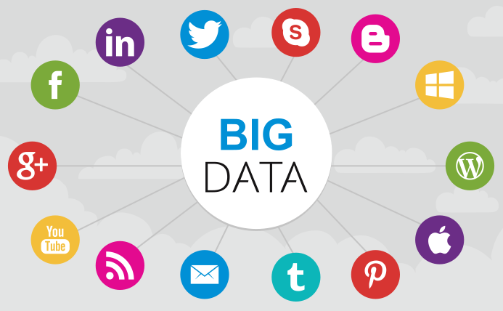
Sources of Big Data
People and their activities generate data
Social media (e.g., Facebook, Instagram, Twitter, LinkedIn)
Video sharing (e.g., YouTube, TikTok)
Blogging and commenting on a website
Internet searches
Text messages (e.g., SMS, Whatsapp, Signal, Telegram)
Personal documents (e.g., Google Docs, emails)
Pros
Highly valuable for business intelligence
Allow personalization
Cons
Typically unstructured data
Text, images
It takes investment before you can reap the value
Acquire → Store → Clean → Retrieve → Process → Insights
Surveillance capitalism

Slide 26
Sources of Big Data
Organizations generate data
Commercial transactions
Credit cards
E-commerce
Banking
Financial information
Medical records
Transactions
Clicks on a website
Pros
Highly structured
Cons
Store every event in the past to predict the future
Stored in “data silos” with different data models
Each department has its own data system
Additional complexity, missing opportunities, data is outdated / not visible
Cloud computing helps (e.g., data lakes, data warehouses)

Slide 27
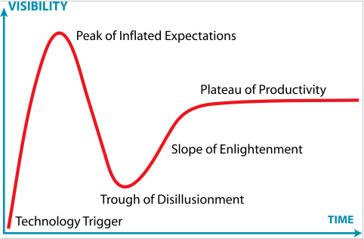
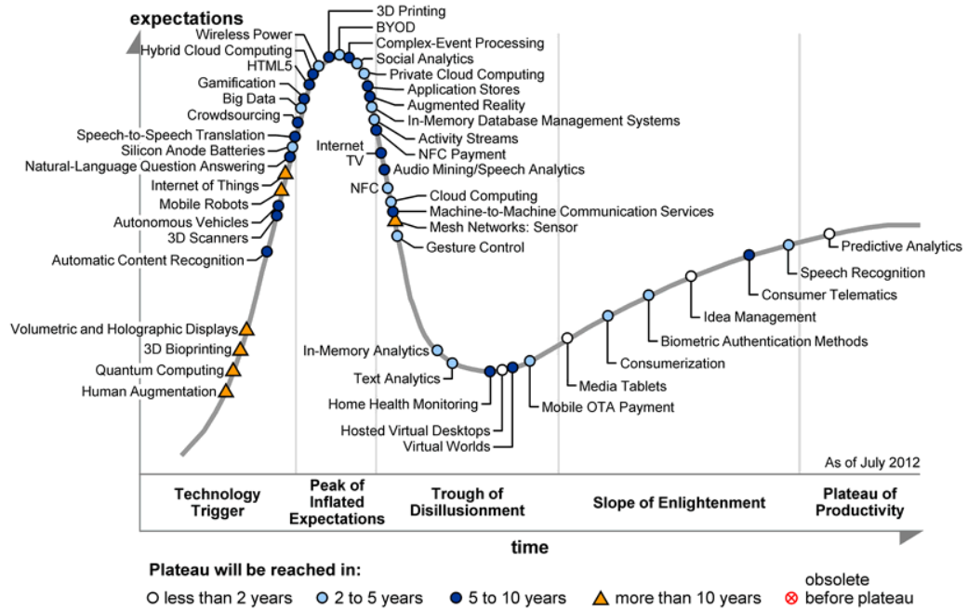
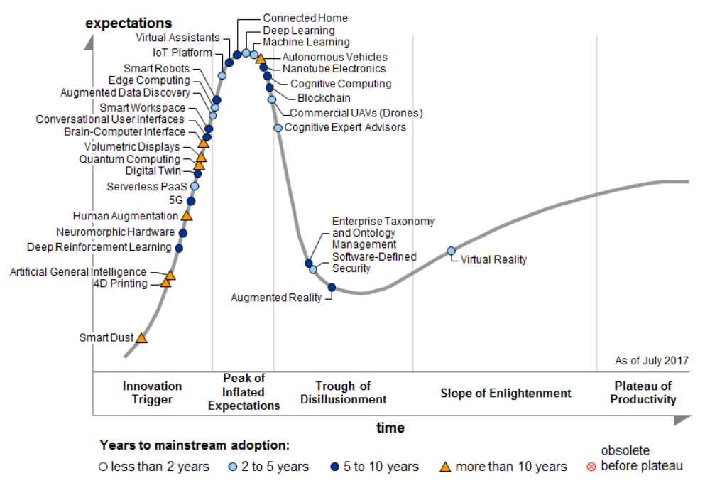
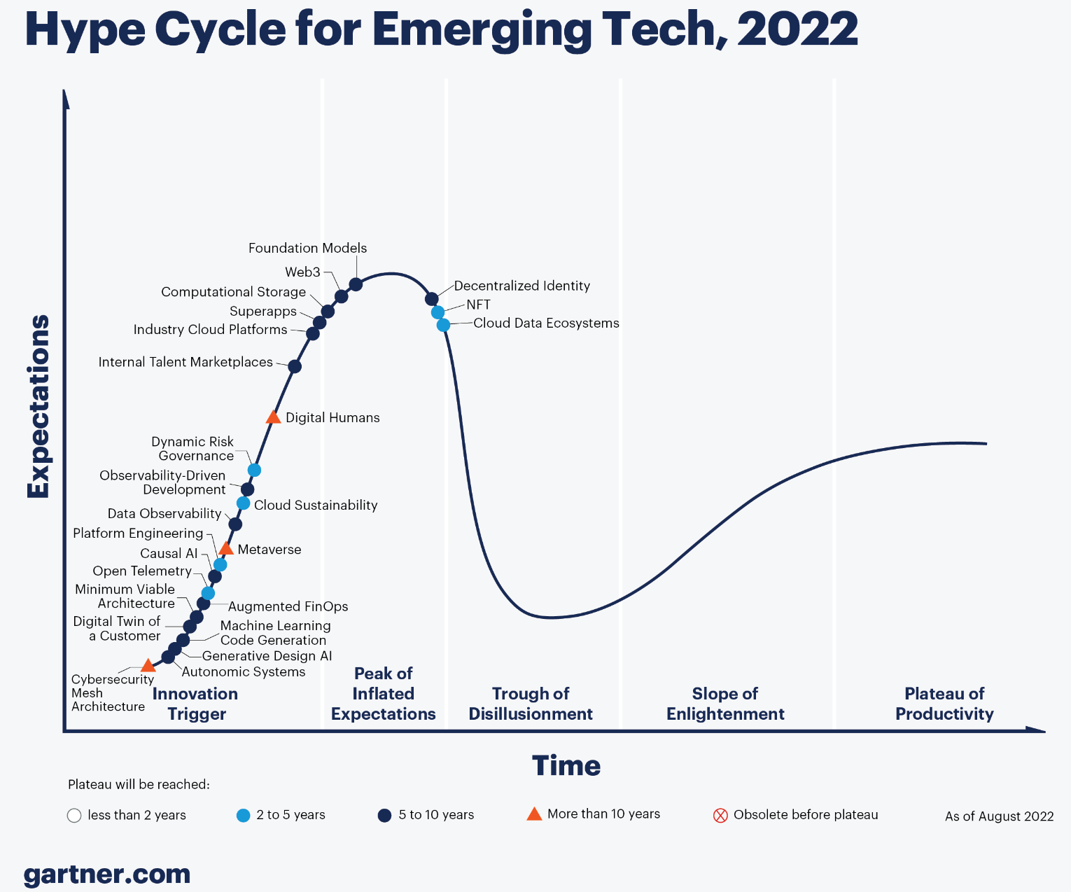
Big Data + Data Science to the Rescue
Big data and data science often used synonymously:
Aka data analytics, data mining, business intelligence, predictive analytics
Loosely used for any process where interesting information are inferred from data
Data scientist called the “sexiest job” of the 21st century
The term has becoming very muddled at this point

Slide 28
Is Data Science Just Hype?
No
Extracting insights and knowledge from data:
Is very important
Will continue to increase in importance
Big data techniques are revolutionizing the world in many domains
E.g., education, food supply, disease epidemics, …
But
Not much different from what statisticians have been doing for many years
What is different? What has changed?
Much more data is digitally available than ever before
Easy-to-use programming frameworks (e.g., Hadoop, Spark) = much easier to analyze it
Cloud computing
Often large-scale data + simple algorithms > small data + complex algorithms

Slide 29
Key Shifts Before / After Big-Data
Datasets: small, curated, clean → large, uncurated, messy
Before:
Statistics based on small, carefully collected random samples
Costly and careful planning for experiments
Hard to do fine-grained analysis
Today:
Easily collect huge volume of data
Feed it into algorithms
Usually the signal is strong enough to overcome the noise
Causation → Correlation
Goal: figure out what caused what
Causation very hard to figure out
Today: give up causation for correlation
Find out that two things are correlated and often that's enough
"Datafication" = process of converting abstract things into concrete data
E.g., "sitting posture" is datafied by capturing information with 100's of sensors placed in your seat
Your preference is datafied into a stream of your likes
From: Rise of Big Data, 2013

Slide 30
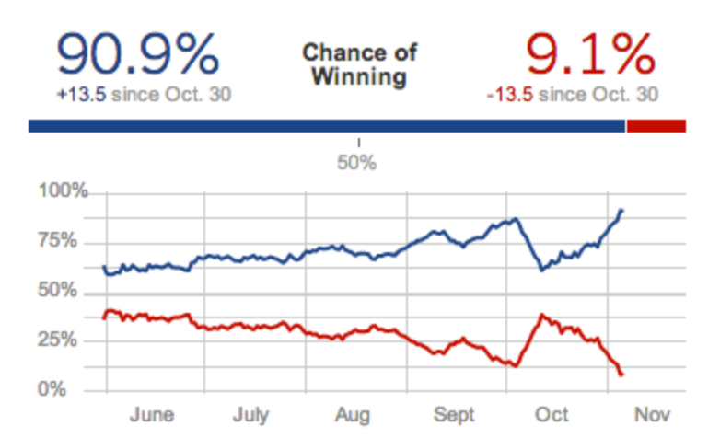
Examples: Election Prediction
Nate Silver and the 2012 Elections
49 out of 50 in calling each state in 2008 US elections
50 out of 50 in 2012 US elections
Didn’t work that well in 2016
Some reasons why he got things right
Many sources of data, irrespective of quality
Incorporation of historical accuracy
Use of statistical models
Understanding correlations
Monte-Carlo simulations to compute the probabilities of electoral college
Focus on probabilities instead of predictions
Great communication and presentation skills

Slide 31
Examples: Google Flu Trends
Google Flu Trends
Early warning of flu outbreaks by analyzing search queries
What terms people searched for (45 search terms used to create a single model)
IP to determine location
Application of “collective intelligence”
Predict regional outbreaks of flu up to 1 or 2 weeks ahead of CDC
5% to 20% of US population contract flu every year and 40k deaths
Earlier warnings allow prevention and control
Service in activity from 2008 to 2015
Caveat: accuracy not as good any more
Google claimed 97% accuracy
Out of sample accuracy lower (overshot CDC data by 30%)
People search about flu without knowing how to diagnose flu (e.g., people searching for “fever” and “cough”)
Google Flu Trends: The Limits of Big Data

Slide 32
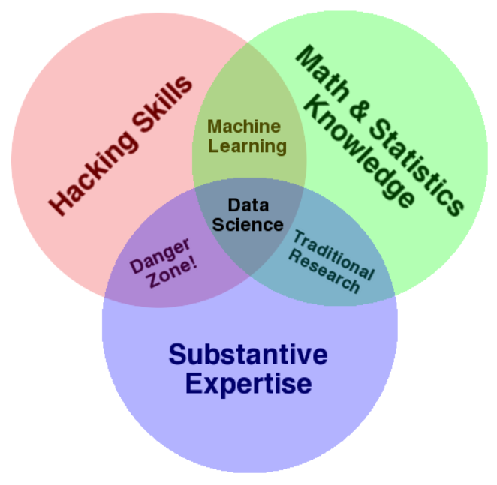
Data Scientist
Very ambiguous and ill-defined term
From Drew Conway's Venn Diagram

Slide 33
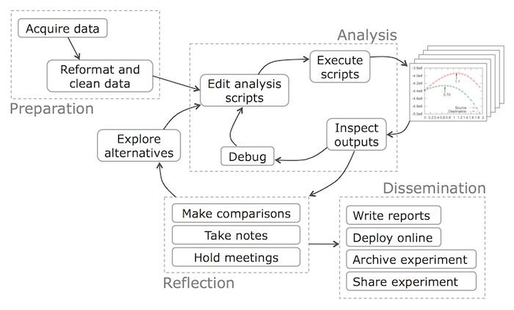
Typical Data Science Workflow
From Data Science Workflow

Slide 34
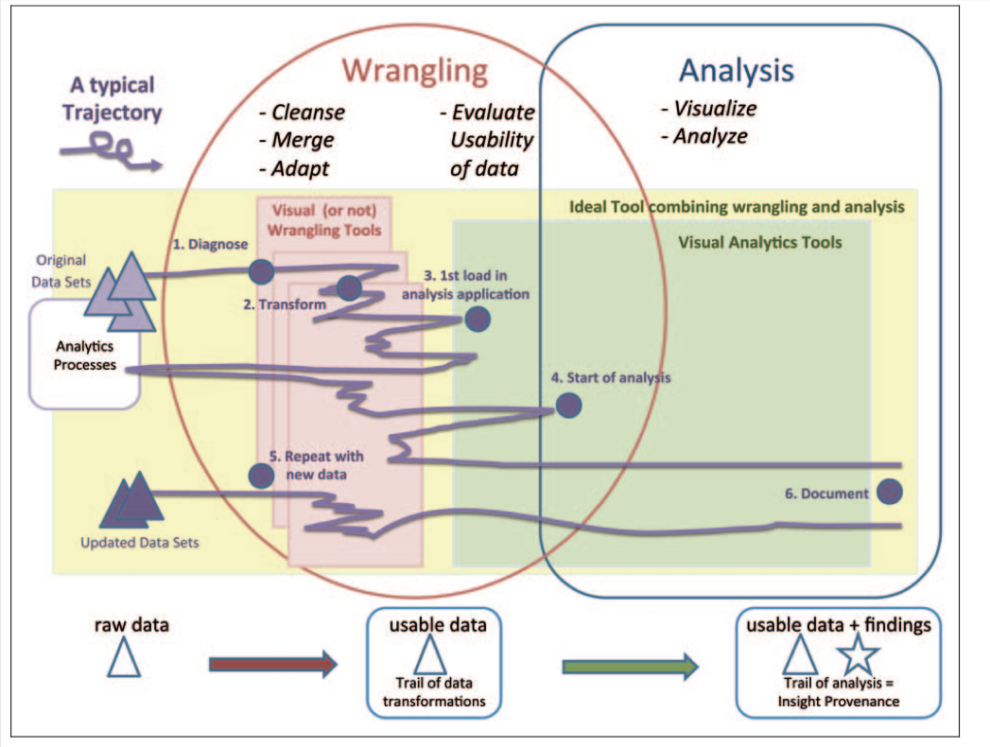
Where Data Scientist Spends Most Time
'Janitor Work' in Data Science;
Research Directions in Data Wrangling
Estimates that 80-90% of the work is in data cleaning and wrangling

Slide 35
What a Data Scientist Should Know
From: How to hire a data scientist
Data grappling skills
How to move data around and manipulate it with some programming language
Scripting languages (e.g., Python)
Data storage tools like relational databases, key-value stores
Programming frameworks like SQL, Hadoop, Spark, etc.
Data visualization experience
How to draw informative pictures of data
Many tools (e.g., D3.js, plotting libraries)
Harder question is knowing what to draw
Knowledge of statistics
E.g., error-bars, confidence intervals
Python libraries; Matlab; R
Experience with forecasting and prediction
Basic machine learning techniques
Communication skills
Communicate the findings
We focus here!!!

Slide 36
UMD DATA605 - Big Data Systems Course Intro
Big data Data Models

Slide 37
Data Models
Data modeling
= process of representing and capturing the structure and properties of real-world entities
Process of abstraction: real-world → representation
Data model
= description of how data is represented (e.g., relational, key-value) and accessed (e.g., allowed operations, how to query)
E.g., schema in a DB describe a specific collection of data, using a given data model
Why do we need data model?
Need to know the structure of the data (to some extent) to be able to write general purpose code
Allow to share data across programs, organizations, systems
Need to integrate information from multiple sources
Preprocess data to make access efficient (e.g., building an index on a data field)

Slide 38
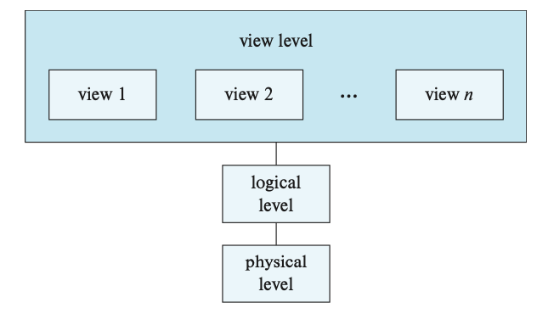
Multiple Layers of Data Modeling
Physical layer
How is the data physically stored
How to represent complex data structures (e.g., B-trees for indexing)
Logical layer
Type of information stored
Entities
Entity attributes
Relationships among the above
Views
Restrict information flow
Security and/or ease-of-use

Slide 39
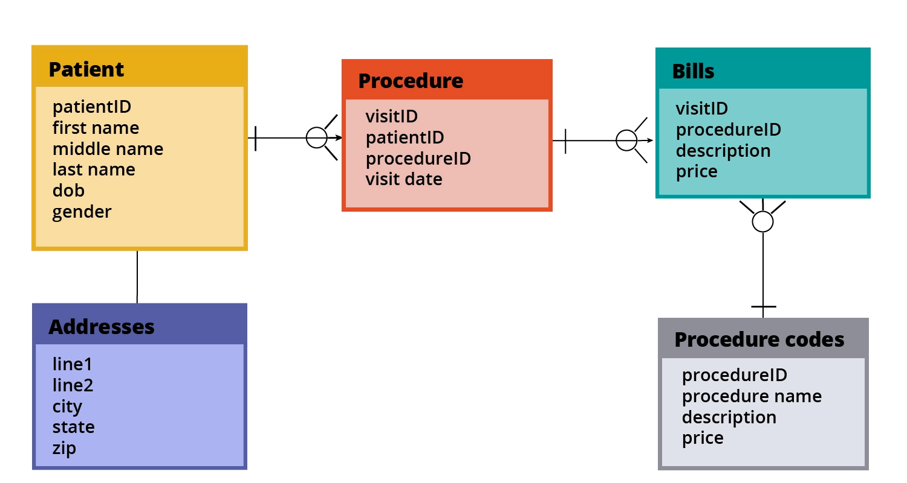
Data Models: Logical Layer
Modeling constructs
A collection of concepts used to represent the structure in the data, e.g.,
Types of entities
Entity attributes
Types of relationships between entities
Types of relationships between attributes
Integrity constraints
Constraints to ensure data integrity
Goal: avoid errors and data inconsistencies
E.g., a field can’t be empty, is an integer
Manipulation constructs
E.g., insert, query, update, delete data

Slide 40
Examples of Data Models
We will cover:
Relational model (SQL)
Entity-relationship (ER) model
XML
Object-oriented (OO)
Object-relational
RDF
Property graph
Serialization formats are also data models
CSV
Parquet
JSON
Protocol Buffer
Avro / Thrift
Python Pickle

Slide 41
Good Data Models
We would like a data model to be:
Expressive
Capture real-world data well
Easy to use
Good performance
Tension between the above characteristics
More powerful models
Can represent more datasets
Harder to use, to query
Less efficient
The evolution of data modeling tools is an attempt to capture the structure in the data
Structured data → Relational DBs
Semi-structured web data → XML
Unstructured data → NoSQL DBs

Slide 42
Data Independence
Logical data independence
Can change the representation of data without changing programs that operate on it
Physical data independence
Can change the layout of data on disk and programs won't change
Index the data
Partition / distribute / replicate the data
Compress the data
Sort the data

Slide 43
Databases: A Brief History
1960s: Early beginning
Computers finally become attractive technology
Enterprises start adopting computers
Most applications initially used their own data stores
Each application had its own format
Data was basically unavailable to other programs
Database: term coined in military information systems to denote "shared data banks" by multiple applications
Define a data format
Store it as a "data dictionary" (schema)
Implement general-purpose "database management" software to access data
Issues:
How to write data dictionaries?
How to access data?
Disadvantages of integration: integrity, security, privacy concerns
Who controls the data?
Notes:
Silber 1.9

Slide 44
Databases: A Brief History
Birth of "hierarchical model" and "network model"
Both allowed connecting records of different types
E.g., connect accounts with customers
Network model attempted to be very general and flexible
IBM designed IMS hierarchical database in 1966 for the Apollo space program
Predates hard disks
Still around today!
.. more than 95 percent of the top Fortune 1000 companies use IMS to process 50 billion transactions a day and manage 15 million gigabytes of critical business data (from IBM Website on IMS)
Cons:
Hierarchical / network models exposed too much of the internal data (e.g., structures / pointers to the users)
Leaky abstraction

Slide 45
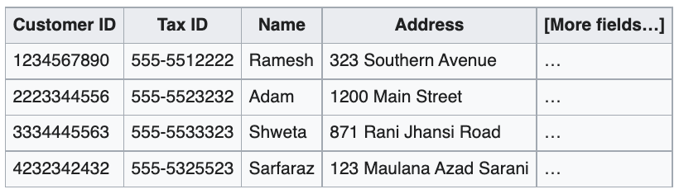
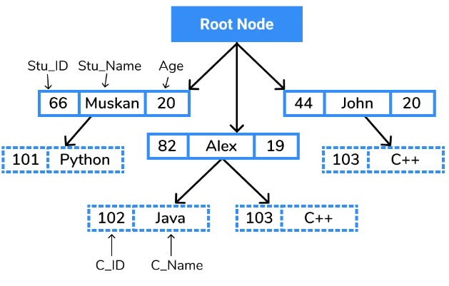
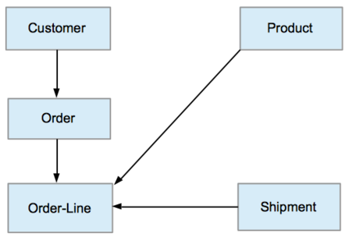
Relational, Hierarchical, Network model
Relational model
Data is represented as tuples grouped in relation
Omnipresent SQL
Hierarchical model
Data is organized into a tree-like structure
Each record has one parent record and many children
Records connected through links
Resurgence in 1990s with XML DBs
Network model
Data is organized in a graph
Each record can have multiple parent and child records
Resurgence in 2010s with graph DBs

Slide 46
Databases: A Brief History
1970s: Relational model
Set Theory, First-order predicate logic
Ted Codd developed the Relational Model
Elegant, formal model
Provided almost complete data independence
Users didn't need to worry about how the data was stored, processed
High level query language
SQL based on relational algebra
Notion of normal forms
Allowed one to reason about
Remove redundancies
Influential projects: INGRES (UC Berkeley), System R (IBM)
Didn't care about IMS/IDMS compatibility (as IBM had to)
Many debates between Relational Model vs Network Model proponents

Slide 47
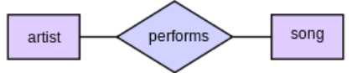
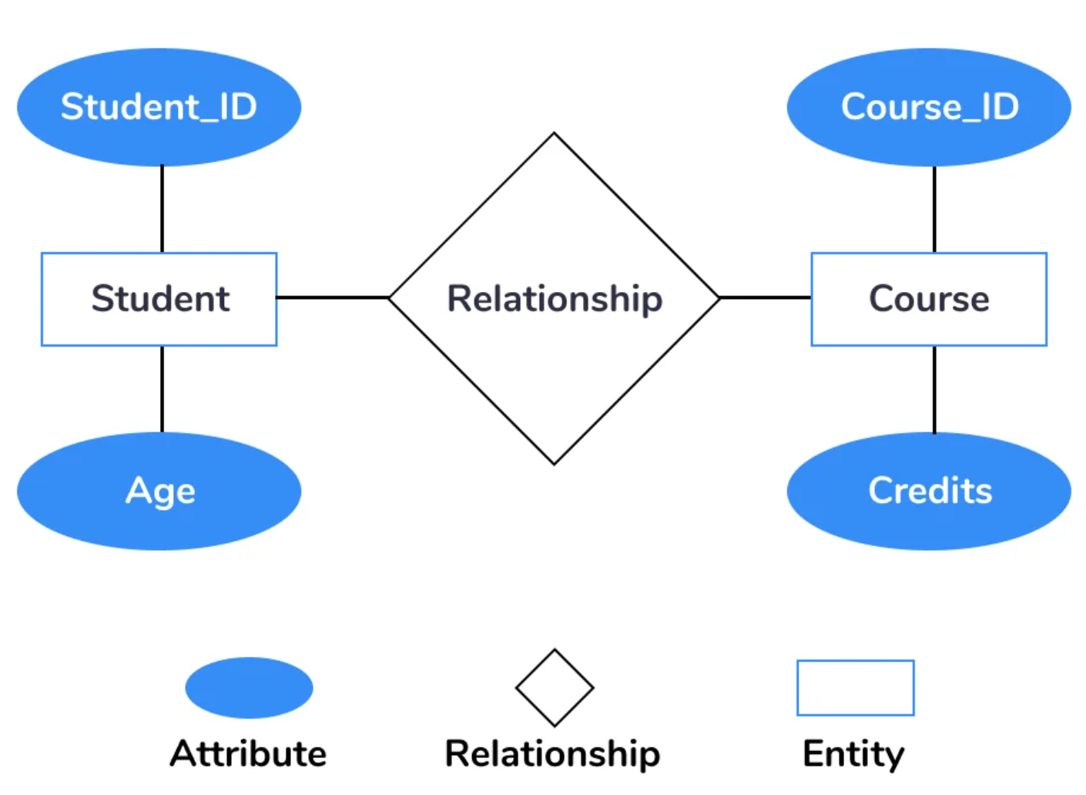
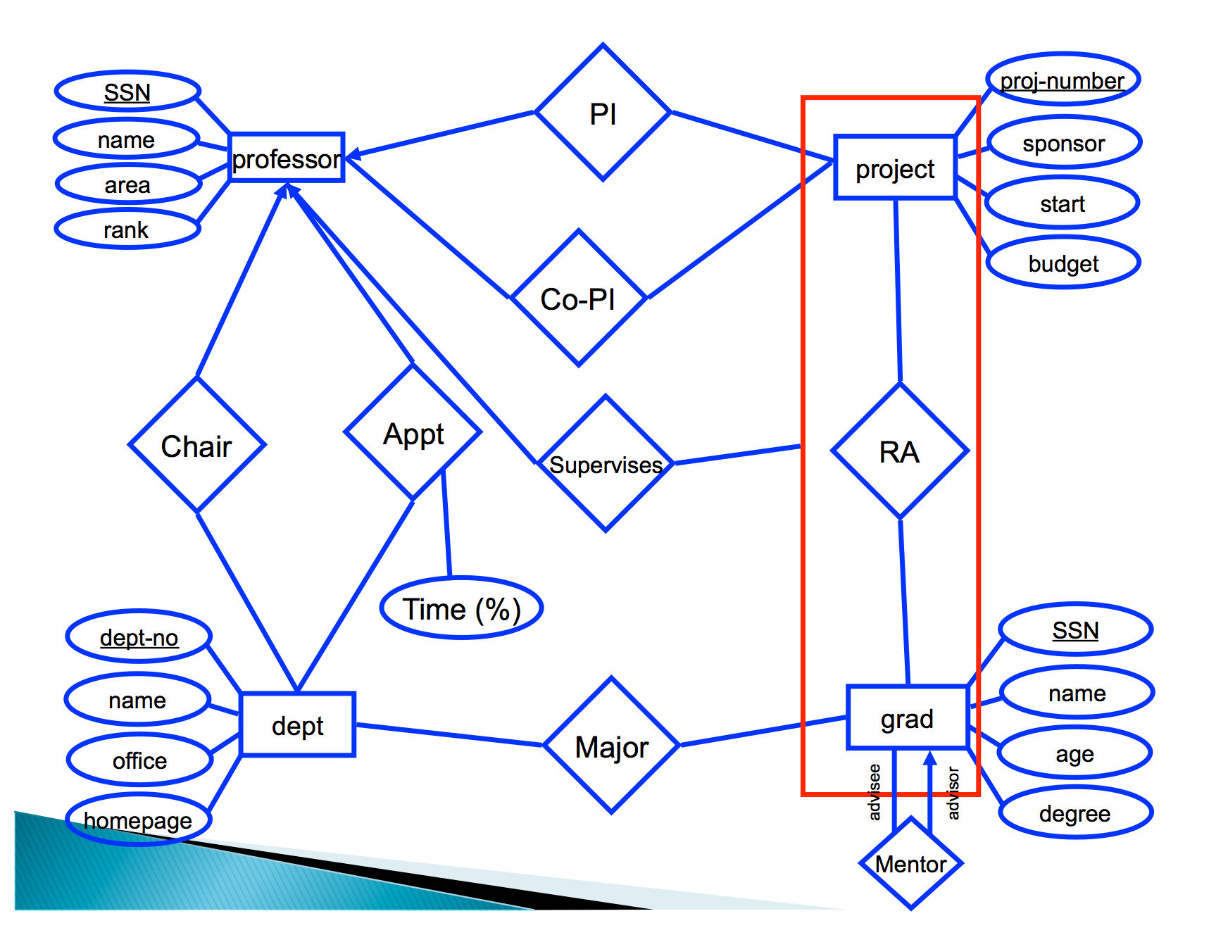
Entity-Relationship Model
1976: Peter Chen proposed "Entity-Relationship Model"
Data model describing knowledge in terms of entities and relationships
Entities are physical or logical objects that can be uniquely identified
“Nouns”
Relationships between entities
“Verbs”
An ER model can be mapped onto a relational DB
Entities, relationships -> tables
Notes:
Entities are nouns – rectangles in diagram
Relationships are verbs – diamonds in diagram
Both can have attributes – circles in diagram

Slide 48
Databases: A Brief History
1980s: Widespread acceptance of relational model
SQL emerged as a standard, in large part because of IBM's backing
Enriching the expressive power of relational model
Set-valued attributes, aggregation, etc.
Late 80's
Object-oriented DB
Store objects instead of tables
Get around impedance mismatch between programming languages and databases
Object-relational DB
Allow user-defined types
Get many benefits of object-oriented while keeping the essence of relational model
No expressive difference from pure relational model

Slide 49
Object-Oriented
OOP is a data model
Object behavior is described through data (stored as fields) and code (in the form of methods)
Composition
Aka `has-a` relationships
E.g., an Employee class has an Address class
Inheritance
Aka `is-a` relationships
E.g., an Employee class derives from a Person class
Polymorphism
Code executed depends on the class of the object
One interface, many implementations
E.g., `draw()` method on a Circle vs Square object, both descending from Shape class
Encapsulation
E.g., private vs public fields / members
Prevents external code from being concerned with inner workings of an object

Slide 50
Databases: A Brief History
Late 90's-today
Web emerges
XML: eXtensible Markup Language
Intended for semi-structured data
Tree-like structure
Flexible schema
<?xml version="1.0" encoding="UTF-8"?> <!-- Edited by XMLSpy -→ <CATALOG>
<CD> <TITLE>Empire Burlesque</TITLE>
<ARTIST>Bob Dylan</ARTIST>
<COUNTRY>USA</COUNTRY>
<COMPANY>Columbia</COMPANY>
<PRICE>10.90</PRICE> <YEAR>1985</YEAR> </CD> <CD> <TITLE>Hide your heart</TITLE> <ARTIST>Bonnie Tyler</ARTIST> <COUNTRY>UK</COUNTRY> <COMPANY>CBS Records</COMPANY> <PRICE>9.90</PRICE> <YEAR>1988</YEAR> </CD> ...

Slide 51
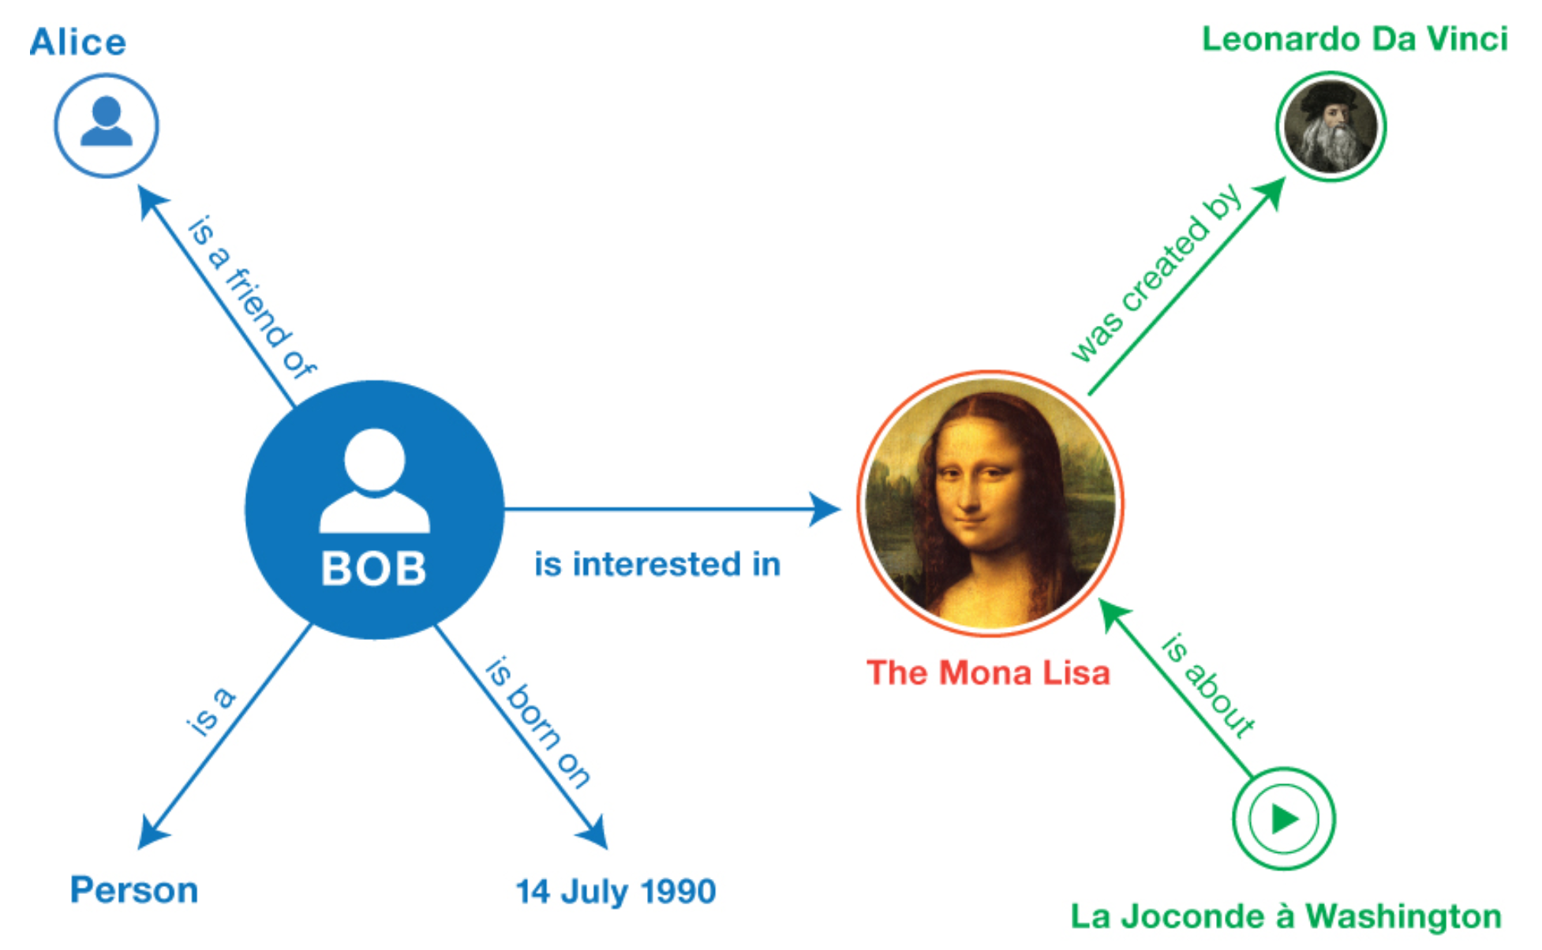
Resource Description Framework
Aka RDF
Key construct: a "subject-predicate-object" triple
E.g.,
subject=sky
predicate=has-the-color
object=blue
Can be mapped to a labeled, directed multi-graph
More general than a tree
Typically stored in:
Relational DBs
Dedicated "triple-stores” DBs
01 <http://example.org/bob#me> <http://www.w3.org/1999/02/22-rdf-syntax-ns#type> <http://xmlns.com/foaf/0.1/Person> .
02 <http://example.org/bob#me> <http://xmlns.com/foaf/0.1/knows> <http://example.org/alice#me> .
03 <http://example.org/bob#me> <http://schema.org/birthDate> "1990-07-04"^^<http://www.w3.org/2001/XMLSchema#date> .
04 <http://example.org/bob#me> <http://xmlns.com/foaf/0.1/topic_interest> <http://www.wikidata.org/entity/Q12418> .
05 <http://www.wikidata.org/entity/Q12418> <http://purl.org/dc/terms/title> "Mona Lisa" .
06 <http://www.wikidata.org/entity/Q12418> <http://purl.org/dc/terms/creator> <http://dbpedia.org/resource/Leonardo_da_Vinci> .
07 <http://data.europeana.eu/item/04802/243FA8618938F4117025F17A8B813C5F9AA4D619> <http://purl.org/dc/terms/subject> <http://www.wikidata.org/entity/Q12418> .

Slide 52
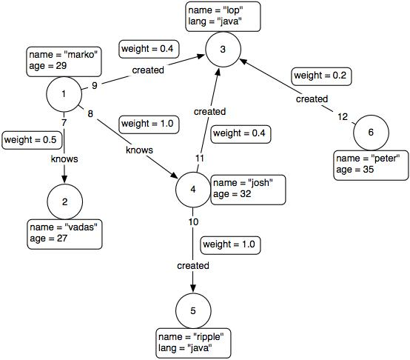
Property Graph Model
Graph:
with vertices and edges
with properties associated with each edge and vertex
Typically stored in:
Relational DBs
Graph DBs

Slide 53
Serialization Formats
Programs need to send data to each other (on the network, on disk)
E.g., Remote Procedure Calls
JSON, YAML, Protocol Buffer
Several recent technologies based around schemas
Are data models

Slide 54
JSON
JSON = JavaScript Object Notation
Data is nested dictionaries and arrays
Very similar to XML
More human-readable
Less boilerplate
Executable in JavaScript (and Python)
{ "firstName": "John", "lastName": "Smith", "isAlive": true, "age": 25, "height_cm": 167.6, "address": { "streetAddress": "21 2nd Street", "city": "New York", "state": "NY", "postalCode": "10021-3100" },
"phoneNumbers": [ { "type": "home", "number": "212 555-1234” }, { "type": "office", "number": "646 555-4567" } ], "children": [], "spouse": null }

Slide 55
Protocol Buffers
Developed by Google
Open-source
Represent data structures in a
Language agnostic
Platform agnostic
Versioning
Schema is mostly relational
Optional fields
Types
Default values
Structures
Arrays
Schema specified using a .proto file
Compiled by protoc to produce C++, Java, or Python code to initialize, read, serialize objects
message Person {
optional string name = 1;
optional int32 id = 2;
optional string email = 3;
enum PhoneType {
MOBILE = 0;
HOME = 1;
WORK = 2;
}
message PhoneNumber {
optional string number = 1;
optional PhoneType type = 2;
}
repeated PhoneNumber phones = 4;
}
import addressbook_pb2
person = addressbook_pb2.Person()
person.id = 1234
person.name = "John Doe"
person.email = "jdoe@example.com"
phone = person.phones.add()
phone.number = "555-4321"
phone.type = addressbook_pb2.Person.HOME

Slide 56
Serialization Formats
Avro
Richer data structures
JSON-specified schema
Thrift
Developed by Facebook
Now Apache project
More languages supported
Supports exceptions and sets
{ "namespace": "example.avro", "type": "record", "name": "User", "fields": [ {"name": "name", "type": "string"}, {"name": "favorite_number", "type": ["int", "null"]}, {"name": "favorite_color", "type": ["string", "null"]} ] }

Slide 57
Class Project: TODOs
Clone / look DATA605 - Class project
Look at Sorrentum GitHub repo
Two project examples
Download price data from Binance
Download Reddit data
Complete the survey
Take a look at list of projects
By next lesson:
Dr Saggese + TA create teams and assign a project

